Slide 1


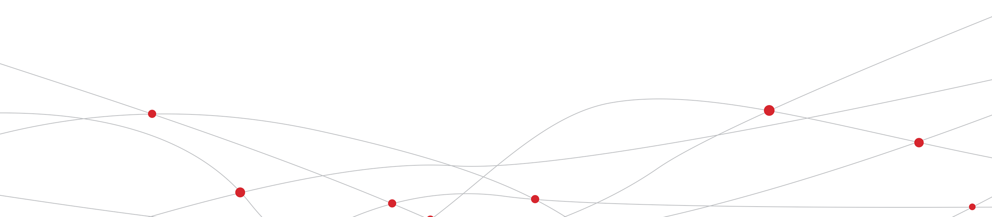
IC Consumption
2019.9.26

Slide 2
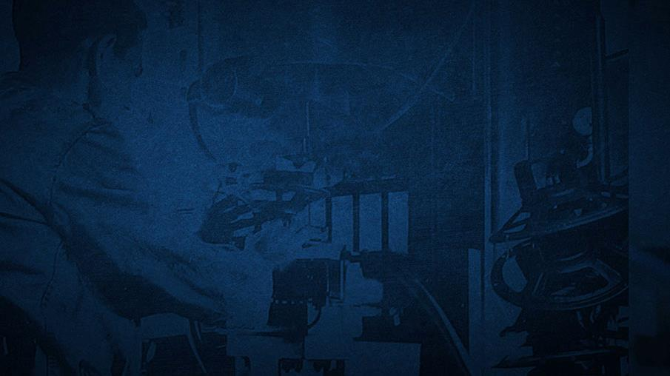
Test preparation

Slide 3
Test preparation

